Slide 1
Using the band model draw diagrams to explain the differences in conduction properties of:
An Earth Alkaline Metal
An insulator
An extrinsic p-type semiconductor
(extrinsic semiconductor非本征半导体，含杂质半导体）

Slide 2
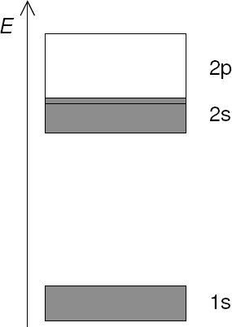
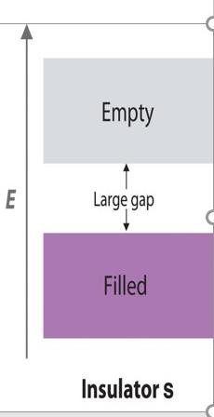
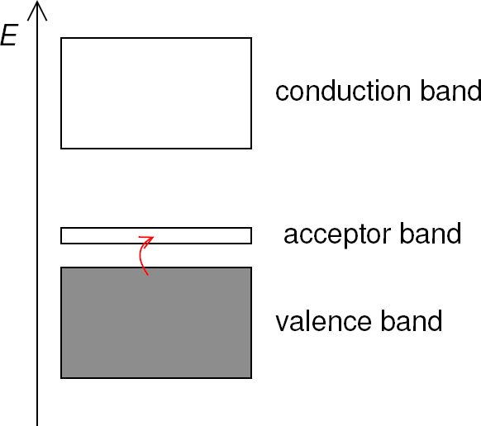
Earth Alkaline Metal While the 2s band is full, it overlaps with the 2p band.
As such, some electrons in the valence band can easily be excited into the conduction band.
The conduction band (band containing the lowest energy empty states) is the 2p band
P-type semiconductor
valence band is completely full and the conduction band is completely empty.
The dopant provides an additional empty band that is lower in energy than the conduction band. Electrons in the valence band are more easily excited into this acceptor band (compared to the conduction band).
Insulator
The size of the band gap is much larger than k_{B}·T, you have an insulator. e.g.
diamond: ~200×k_{B}·T

Slide 3
Using orbital theory, explain the formation of orbitals that lead to conduction in Na (draw suitable energy diagrams and draw the shape of all orbitals involved, the phases, position of nuclei and nodes; consider 8 atoms of Na as an example).

Slide 4
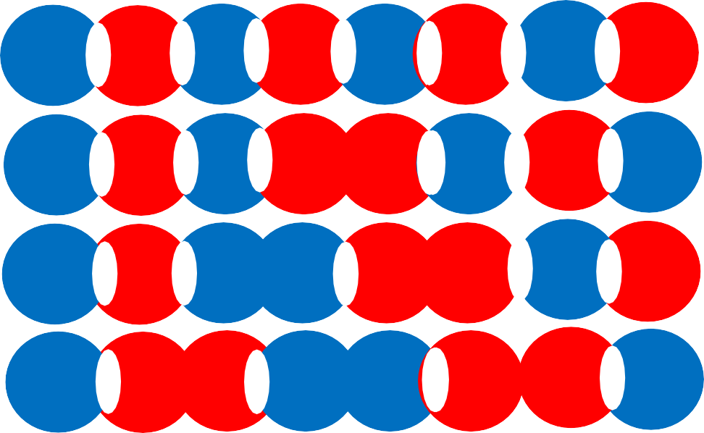
8 x .
3s atomic orbitals, 8 valence electrons
. . .
. . . . .
State 8
nodes 7
. . . . .. . .
. . . . . . . .
. . . . . . . .
. . . . . . . .
. . . . . . . .
. . . . . . . .
. . . . . . . .
State 7
nodes 6
State 6
nodes 5
State 5
nodes 4
Energy
State 4
nodes 3
State 3
nodes 2
State 2
nodes 1
State 1
nodes 0

Slide 5
8 x .
3s atomic orbitals, 8 valence electrons
. . . . .
. . .
. . . . ..
. . . . . .
. . . . . .
. .
. .
. .
.
Energy
. . . . . . .
. . . . . . . .
. . . . . . .
. . . . . . . .
.

Slide 6
8 x .
3s atomic orbitals, 8 valence electrons
3s Valence
Band half filled
Energy

